Slide 1
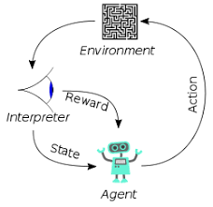
004 DL: Neural Network
Peter H. Chen

Slide 2
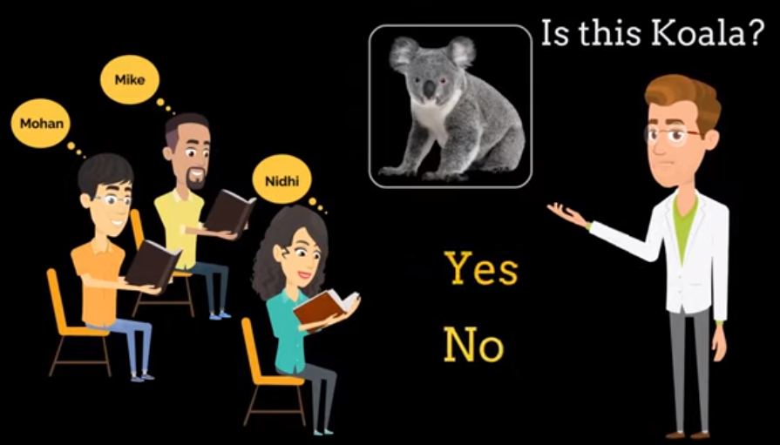
004 DL: Neural Network
https://www.youtube.com/watch?v=ER2It2mIagI&list=PLeo1K3hjS3uu7CxAacxVndI4bE_o3BDtO&index=4
DL: Neural Network (0:00-0:30/11:00)
Predict Koala.

Slide 3
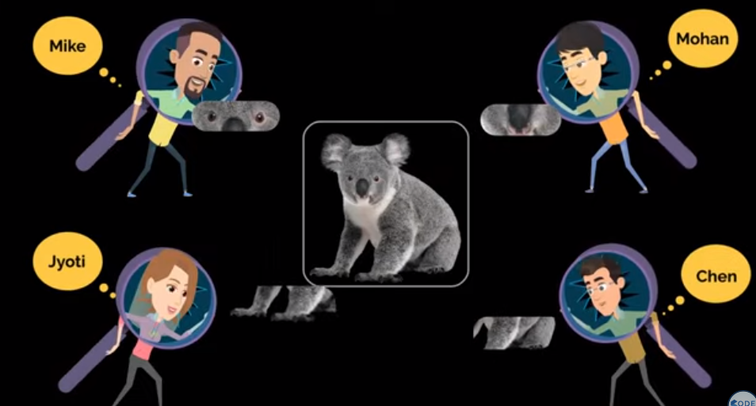
004 DL: Neural Network
https://www.youtube.com/watch?v=ER2It2mIagI&list=PLeo1K3hjS3uu7CxAacxVndI4bE_o3BDtO&index=4
DL: Neural Network (0:30-0:50/11:00)
Each student responsible one part of Koala.
Mike: Eye, Mohan: Nose, Chen: body, Joyti: front legs.

Slide 4
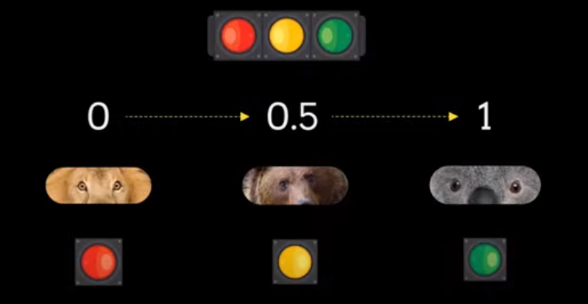
004 DL: Neural Network
https://www.youtube.com/watch?v=ER2It2mIagI&list=PLeo1K3hjS3uu7CxAacxVndI4bE_o3BDtO&index=4
DL: Neural Network (0:50-1:00/11:00)
Predict Koala by eye.
0: no, 0.5: not sure, 1: yes.

Slide 5
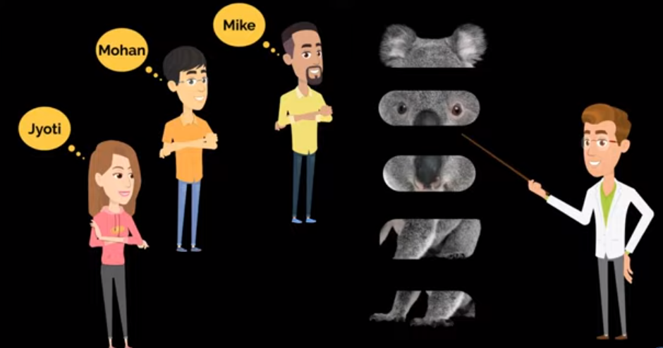
004 DL: Neural Network
https://www.youtube.com/watch?v=ER2It2mIagI&list=PLeo1K3hjS3uu7CxAacxVndI4bE_o3BDtO&index=4
DL: Neural Network (1:01-1:17/11:00)
How exactly train them to predict.

Slide 6
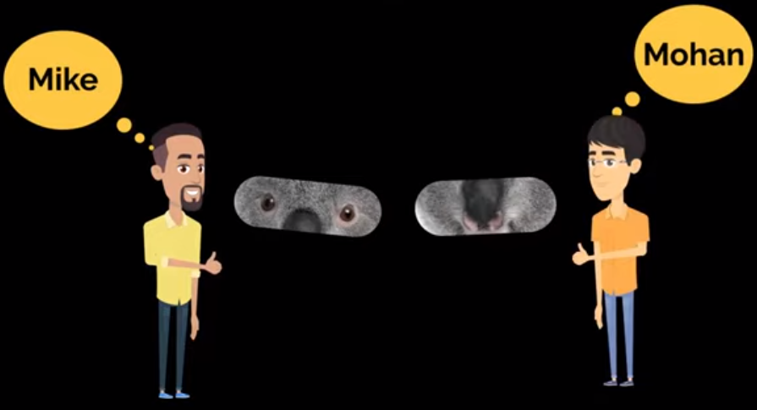
004 DL: Neural Network
https://www.youtube.com/watch?v=ER2It2mIagI&list=PLeo1K3hjS3uu7CxAacxVndI4bE_o3BDtO&index=4
DL: Neural Network (1:30-1:40/11:00)
Mike: Eye Detector
Mohan: Nose detector

Slide 7
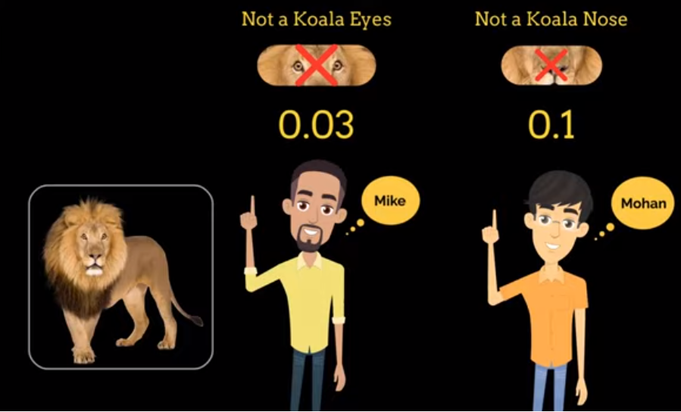
004 DL: Neural Network
https://www.youtube.com/watch?v=ER2It2mIagI&list=PLeo1K3hjS3uu7CxAacxVndI4bE_o3BDtO&index=4
DL: Neural Network (2:00-2:07/11:00)
Mike: Eye
Mohan: Nose

Slide 8
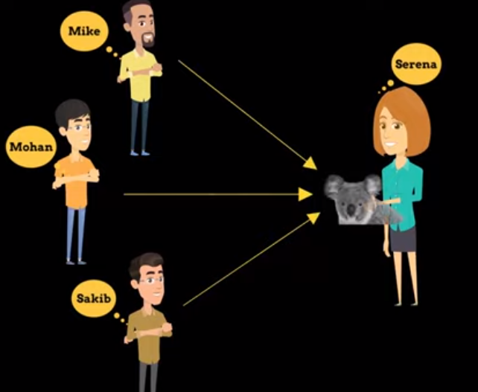
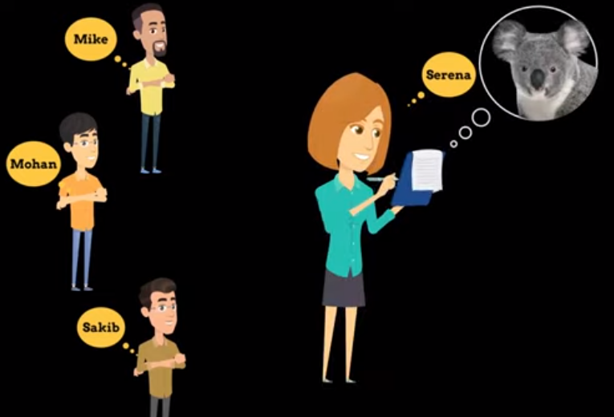
004 DL: Neural Network
https://www.youtube.com/watch?v=ER2It2mIagI&list=PLeo1K3hjS3uu7CxAacxVndI4bE_o3BDtO&index=4
DL: Neural Network (2:00-2:25/11:00)
Mike: Eye
Mohan: Nose
Sakib: ears
All go to Serena to decide the animal is Koala or not.

Slide 9
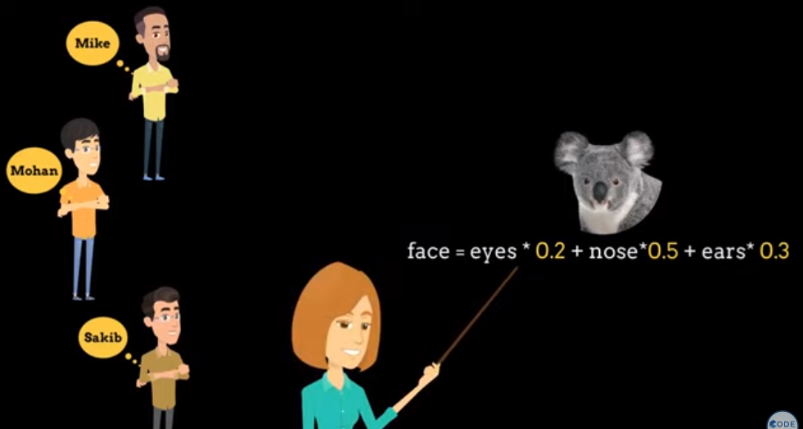
004 DL: Neural Network
https://www.youtube.com/watch?v=ER2It2mIagI&list=PLeo1K3hjS3uu7CxAacxVndI4bE_o3BDtO&index=4
DL: Neural Network (2:30-3:00/11:00)
Serena use this formula to decide the animal is Koala or not.

Slide 10
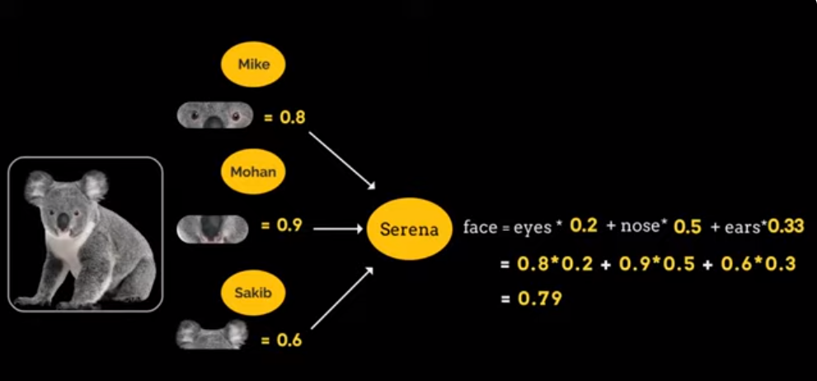
004 DL: Neural Network
https://www.youtube.com/watch?v=ER2It2mIagI&list=PLeo1K3hjS3uu7CxAacxVndI4bE_o3BDtO&index=4
DL: Neural Network (2:30-3:00/11:00)
Serena calculate and decide the animal is Koala or not.
0.79 > 0.5, it is koala.

Slide 11
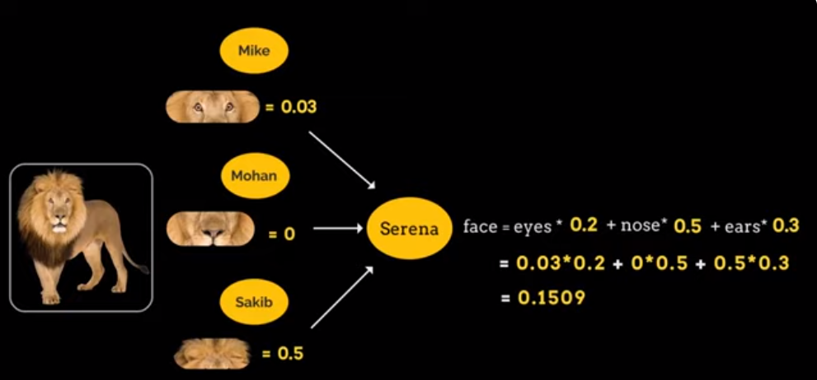
004 DL: Neural Network
https://www.youtube.com/watch?v=ER2It2mIagI&list=PLeo1K3hjS3uu7CxAacxVndI4bE_o3BDtO&index=4
DL: Neural Network (2:30-3:00/11:00)
0.1505 < 0.5, it is not Koala.

Slide 12
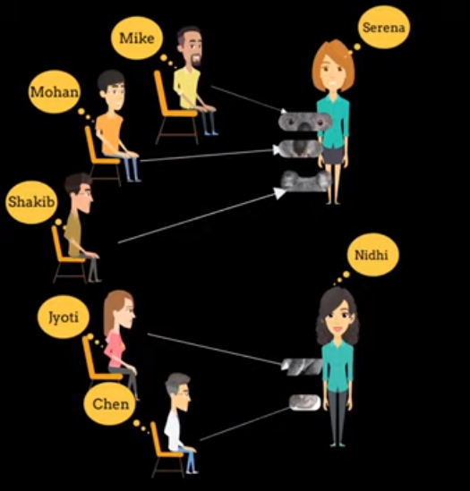
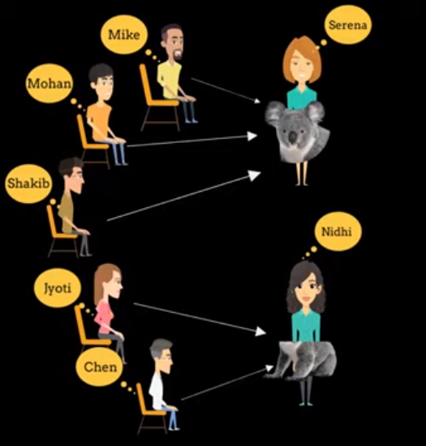
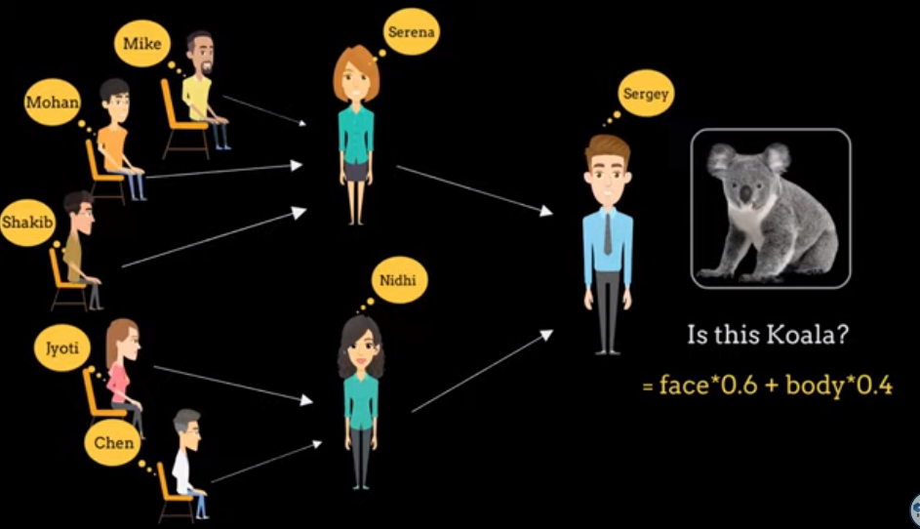
004 DL: Neural Network
https://www.youtube.com/watch?v=ER2It2mIagI&list=PLeo1K3hjS3uu7CxAacxVndI4bE_o3BDtO&index=4
DL: Neural Network (3:01-4:16/11:00)
Mike, Mohan, Shakib to to Serena.
Joyti and Chen go to Nidhi.
Finally, go to Sergey and get the answer.

Slide 13
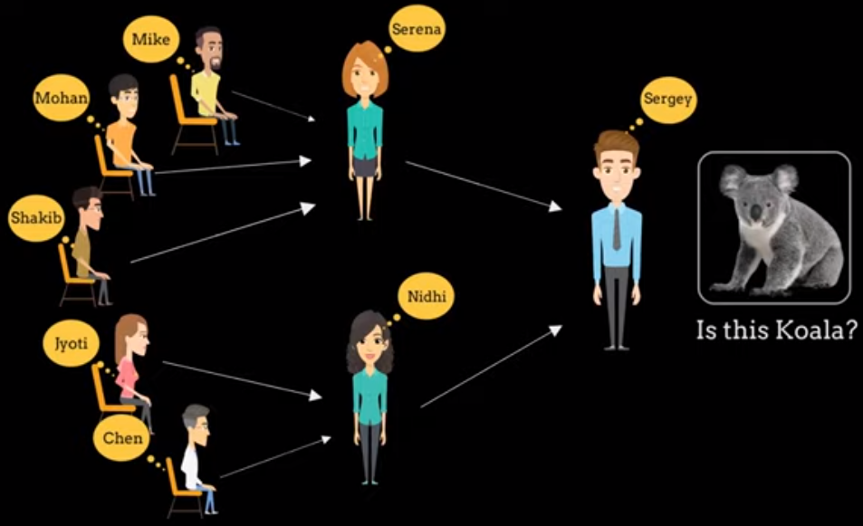
004 DL: Neural Network
https://www.youtube.com/watch?v=ER2It2mIagI&list=PLeo1K3hjS3uu7CxAacxVndI4bE_o3BDtO&index=4
DL: Neural Network (4:20-5:10/11:00)
This is the neural network.
How do you train it?

Slide 14
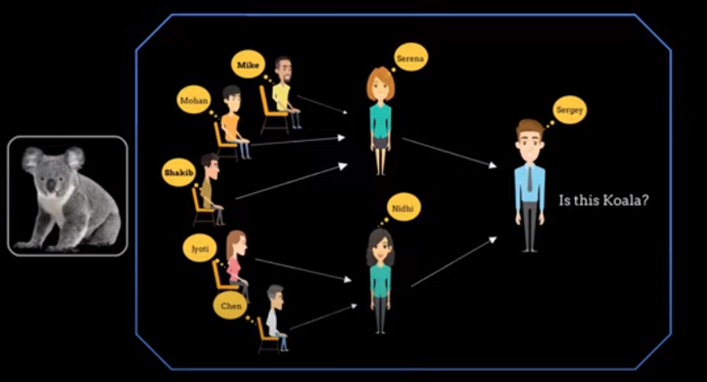
004 DL: Neural Network
https://www.youtube.com/watch?v=ER2It2mIagI&list=PLeo1K3hjS3uu7CxAacxVndI4bE_o3BDtO&index=4
DL: Neural Network (5:11-5:30/11:00)
Initially, each person is random guess the result.

Slide 15
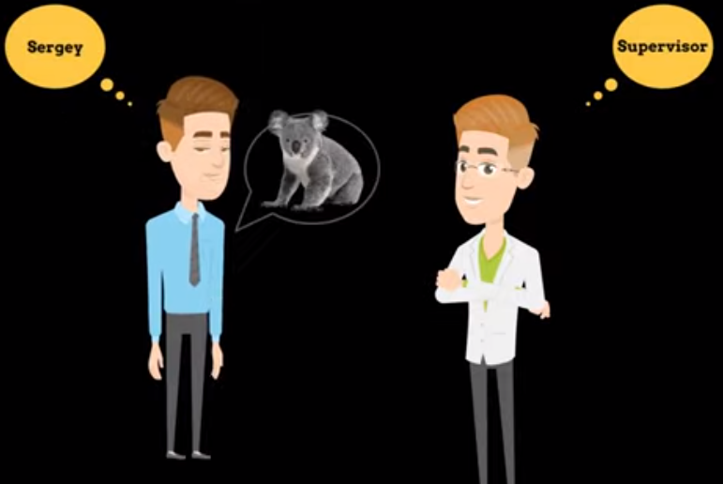
004 DL: Neural Network
https://www.youtube.com/watch?v=ER2It2mIagI&list=PLeo1K3hjS3uu7CxAacxVndI4bE_o3BDtO&index=4
DL: Neural Network (5:31-5:50/11:00)
AT the end, we have supervisor to judge the result is correct or not.
At the beginning, Sergey say, “This does not look like Koala”. Supervisor, say, “It is Koala. Please check your code”.

Slide 16
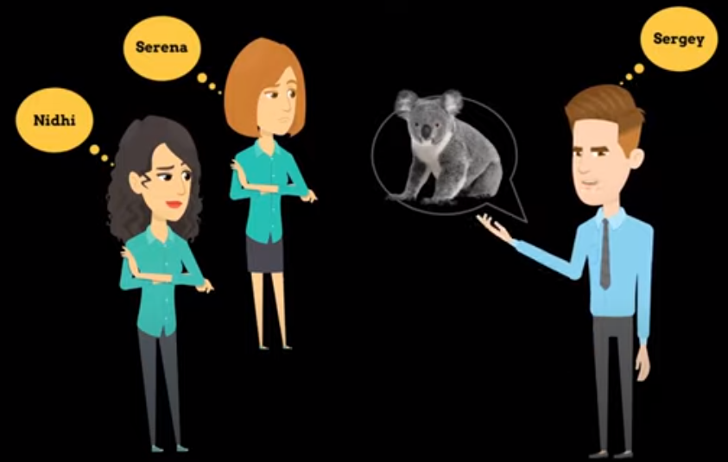
004 DL: Neural Network
https://www.youtube.com/watch?v=ER2It2mIagI&list=PLeo1K3hjS3uu7CxAacxVndI4bE_o3BDtO&index=4
DL: Neural Network (5:51-6:00/11:00)
Sergey go back to middle layers and said “it is Koala”.

Slide 17
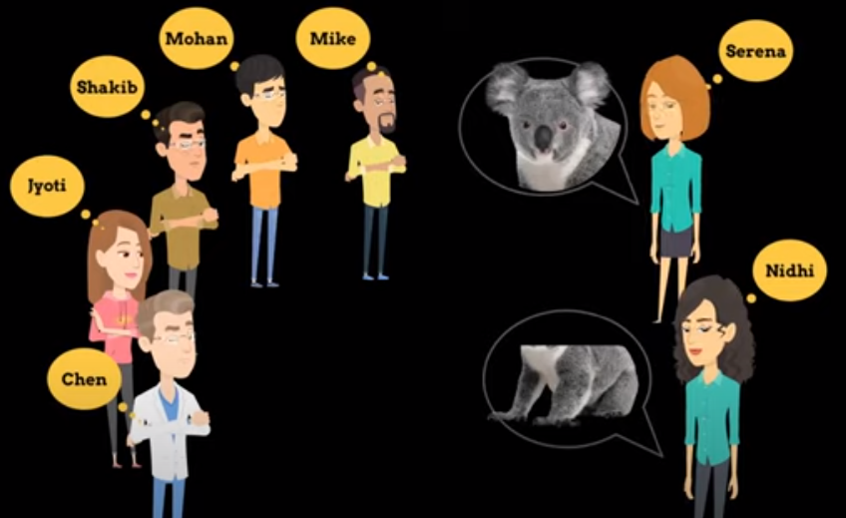
004 DL: Neural Network
https://www.youtube.com/watch?v=ER2It2mIagI&list=PLeo1K3hjS3uu7CxAacxVndI4bE_o3BDtO&index=4
DL: Neural Network (6:01-6:13/11:00)
Middle layer will go back to input and said to inputs, “It is Koala head and body”.
You need to be careful next time.

Slide 18
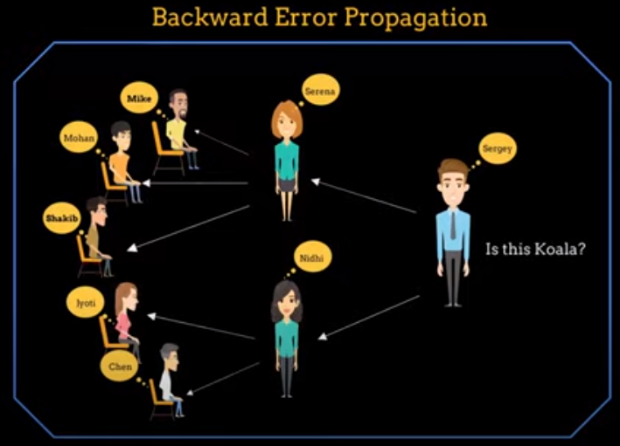
004 DL: Neural Network
https://www.youtube.com/watch?v=ER2It2mIagI&list=PLeo1K3hjS3uu7CxAacxVndI4bE_o3BDtO&index=4
DL: Neural Network (6:15-6:50/11:00)
The error is fixed next time with Backward Error Propagation.

Slide 19
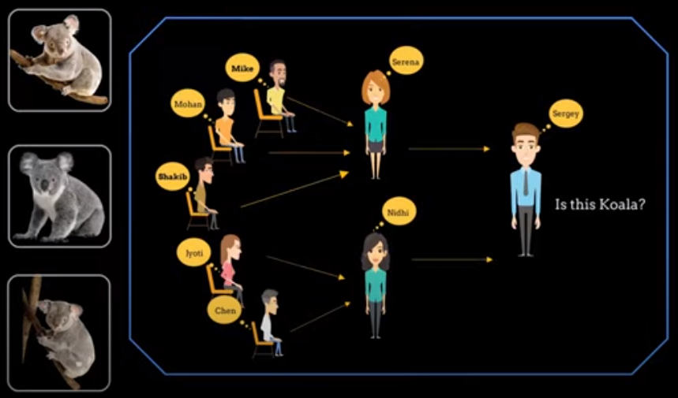
004 DL: Neural Network
https://www.youtube.com/watch?v=ER2It2mIagI&list=PLeo1K3hjS3uu7CxAacxVndI4bE_o3BDtO&index=4
DL: Neural Network (6:50-7:50/11:00)
You can take several Koala images to train. Repeat several times. Initially, errors, and finally correct them

Slide 20
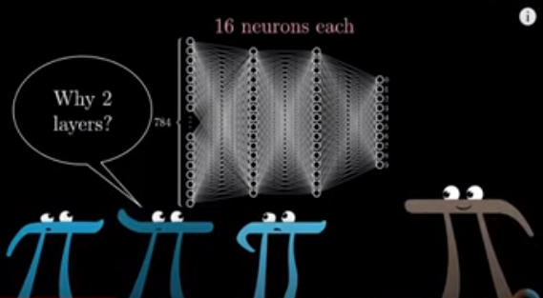
004 DL: Neural Network
https://www.youtube.com/watch?v=ER2It2mIagI&list=PLeo1K3hjS3uu7CxAacxVndI4bE_o3BDtO&index=4
DL: Neural Network (8:00-11:00/11:00)
You can increase layers to improve the prediction accuracy.
Each neuron is distributed computing and very smart.

Slide 21
End

